Slide 1
OPERATING SYSTEM TUTORIAL
Scheduling algorithms and page replacement algorithms implementation on GitHub
Team members
Shamanth g 4ni19cs102
Shubham m sastekar 4ni19cs105

Slide 2
CPU scheduling
CPU Scheduling is a process of determining which process will own CPU for execution while another process is on hold. The main task of CPU scheduling is to make sure that whenever the CPU remains idle, the OS at least select one of the processes available in the ready queue for execution. The selection process will be carried out by the CPU scheduler. It selects one of the processes in memory that are ready for execution.

Slide 3
Scheduler
A dispatcher is a special program When the scheduler completes its job of selecting a process, it is the dispatcher which takes that process to the desired state/queue. The dispatcher is the module that gives a process control over the CPU after it has been selected by the scheduler.
procedure of selecting a process among various processes is done by the scheduler. Once the scheduler has selected a process from the queue, dispatcher takes that process from the ready queue and moves it into the running state. Therefore, the scheduler gives the dispatcher an ordered list of processes which the dispatcher moves to the CPU over time.

Slide 4
Objectives of Process Scheduling Algorithm
Objectives of Process Scheduling Algorithm
Max CPU utilization [Keep CPU as busy as possible]
Fair allocation of CPU.
Max throughput [Number of processes that complete their execution per time unit]
Min turnaround time [Time taken by a process to finish execution]
Min waiting time [Time a process waits in ready queue]
Min response time [Time when a process produces first response]

Slide 5
Different scheduling algorithms
First-Come, First-Served (FCFS): non-preemptive.
Shortest Job First (SJF): non-preemptive.
Longest Job First (LJF): non-preemptive.
Priority Scheduling: both non-preemptive and preemptive versions present.
Shortest Remaining Time First (SRTF): preemptive mode of SJF algorithm.
Longest Remaining Time First (LRTF): preemptive mode of LJF algorithm.
Round Robin(RR):ready queue is treated as a circular queue, CPU scheduler goes around the ready queue, allocating the CPU to each process for a time interval of up to 1-time quantum[preemptive version of FCFS]

Slide 6
TERMINOlogies involved
Arrival Time [AT]: Time at which the process arrives in the ready queue. Completion Time [CT]: Time at which process completes its execution. Burst Time [BT]: Time required by a process for CPU execution. Turn Around Time [TAT]: Time interval from the time of submission of a process to the time of the completion of the process. TAT = CT-AT Waiting Time(W.T): Time processes spend in the ready queue waiting their turn to get on the CPU. WT = TAT – BT.
Response time [RT]:Time spent between the ready state and getting the CPU for the first time

Slide 7
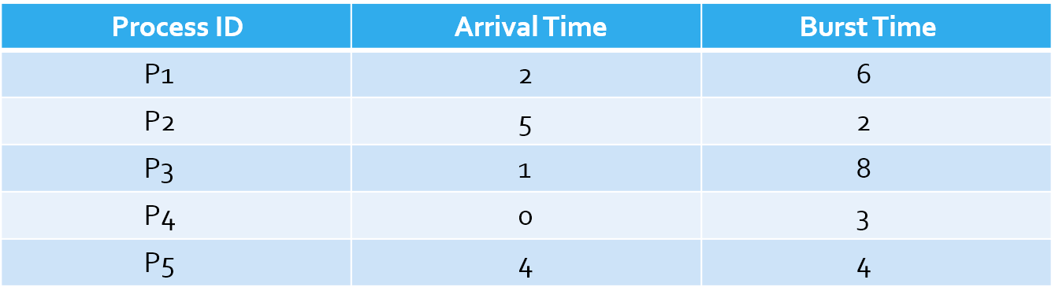
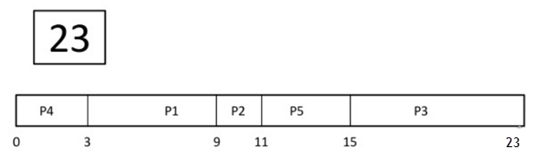
Example
Gantt Chart

Slide 8
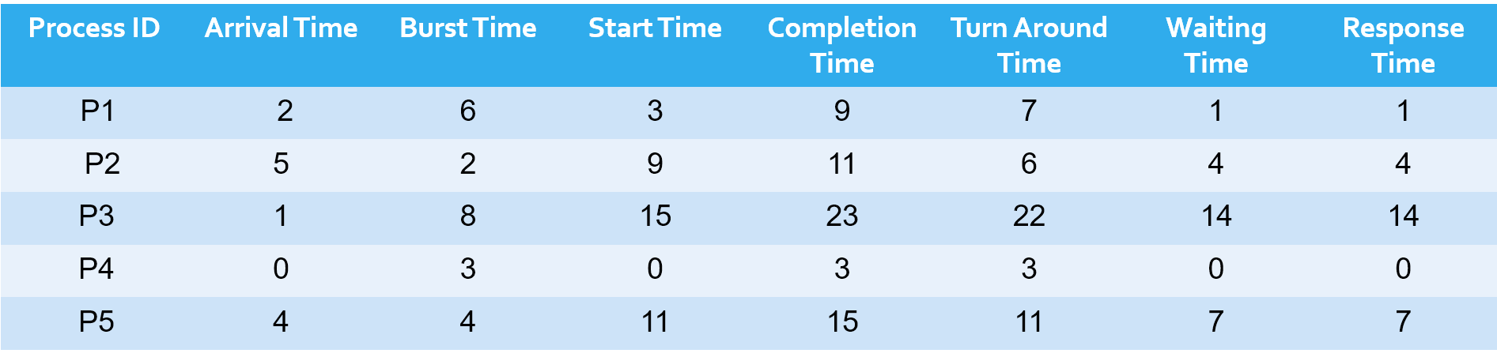
Average Turn Around Time=(7+6+22+3+4)/5=9.8
Average Waiting Time=(1+4+14+0+7)/5=5.2
Average Response Time=(1+4+14+0+7)/5=5.2

Slide 9
Shortest job first
Shortest job first (SJF) or shortest job next, is a scheduling algorithm that selects the waiting process with the smallest execution time to execute next. SJN is a non-preemptive algorithm.
Shortest Job first has the advantage of having a minimum average waiting time among all scheduling algorithms.
It is a Greedy Algorithm.
It may cause starvation if shorter processes keep coming. This problem can be solved using the concept of ageing.
It is practically infeasible as Operating System may not know burst time and therefore may not sort them. While it is not possible to predict execution time, several methods can be used to estimate the execution time for a job, such as a weighted average of previous execution times. SJF can be used in specialized environments where accurate estimates of running time are available.

Slide 10
SJF program [c++]
#include<bits/stdc++.h>
using namespace std;
struct process {
int pid;
int arrival_time;
int burst_time;
int start_time;
int completion_time;
int turnaround_time;
int waiting_time;
int response_time;
};
int main() {
int n;
float avg_turnaround_time;

Slide 11
float avg_waiting_time;
float avg_response_time;
int total_turnaround_time = 0;
int total_waiting_time = 0;
int total_response_time = 0;
int total_idle_time = 0;
cout<<"Enter the number of processes: ";
cin>>n;
struct process p[n];
int is_completed[n];
memset(is_completed,0,sizeof(is_completed));
for(int i = 0; i < n; i++)
{
cout<<"Enter arrival time of process "<<i+1<<": ";
cin>>p[i].arrival_time;
cout<<"Enter burst time of process "<<i+1<<": ";
cin>>p[i].burst_time;
p[i].pid = i+1;
cout<<endl;
}

Slide 12
int current_time = 0;
int completed = 0;
while(completed != n) {
int idx = -1;//index value of procecss with min bt
int mn = 10000000;//mn: store value of procecss with min bt
for(int i = 0; i < n; i++)//select shortest job in ready q
{
if(p[i].arrival_time <= current_time && is_completed[i] == 0)
{ if(p[i].burst_time < mn)
{ mn = p[i].burst_time;
idx = I; }
if(p[i].burst_time == mn) //follow fcfs{
if(p[i].arrival_time < p[idx].arrival_time)
{
mn = p[i].burst_time;
idx = i;
}
}
}
}

Slide 13
if(idx != -1) {
p[idx].start_time = current_time;
p[idx].completion_time = p[idx].start_time + p[idx].burst_time;
p[idx].turnaround_time = p[idx].completion_time - p[idx].arrival_time;
p[idx].waiting_time = p[idx].turnaround_time - p[idx].burst_time;
p[idx].response_time = p[idx].start_time - p[idx].arrival_time;
total_turnaround_time += p[idx].turnaround_time;
total_waiting_time += p[idx].waiting_time;
total_response_time += p[idx].response_time;
is_completed[idx] = 1;
completed++;
current_time = p[idx].completion_time;
}
else //idx==-1
{
current_time++;//CPU idle time
}
}

Slide 14
avg_turnaround_time = (float) total_turnaround_time / n;
avg_waiting_time = (float) total_waiting_time / n;
avg_response_time = (float) total_response_time / n;
cout<<endl<<endl;
cout<<"#P\t"<<"AT\t"<<"BT\t"<<"ST\t"<<"CT\t"<<"TAT\t"<<"WT\t"<<"RT\t"<<"\n"<<endl;
for(int i = 0; i < n; i++) {
cout<<p[i].pid<<"\t"<<p[i].arrival_time<<"\t"<<p[i].burst_time<<"\t"<<p[i].start_time<<"\t"<<p[i].completion_time<<"\t"<<p[i].turnaround_time<<"\t"<<p[i].waiting_time<<"\t"<<p[i].response_time<<"\t"<<"\n"<<endl;
}
cout<<"Average Turnaround Time = "<<avg_turnaround_time<<endl;
cout<<"Average Waiting Time = "<<avg_waiting_time<<endl;
cout<<"Average Response Time = "<<avg_response_time<<endl;
}

Slide 15
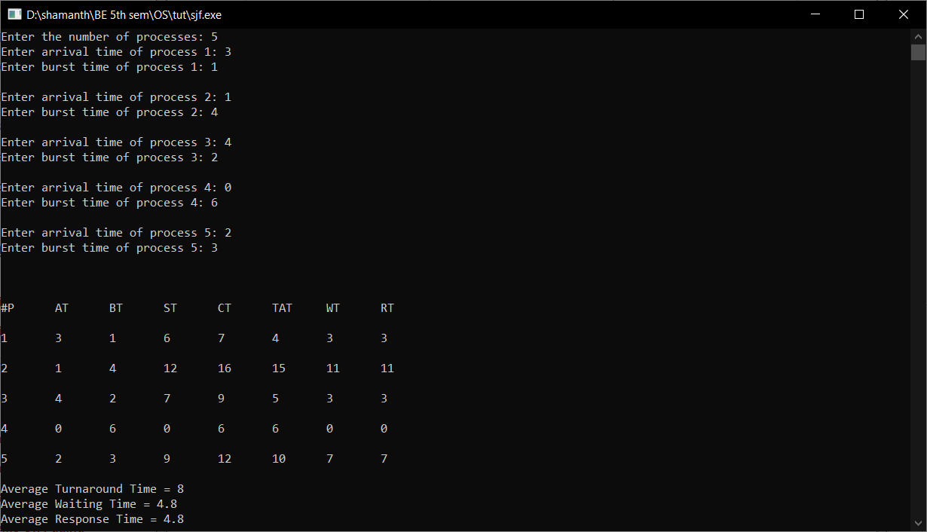
output

Slide 16
First In First Out(Page Replacement Algorithm)
It is one of the simplest page replacement algorithm. The oldest page, which has spent the longest time in memory is chosen and replaced.
This algorithm is implemented by keeping the track of all the pages in the queue.
As new pages are requested and are swapped in, they are added to the tail of a queue and the page which is at the head becomes the victim.
This is not an effective way of page replacement but it can be used for small systems.

Slide 17
ADVANTAGES
This algorithm is simple and easy to use.
FIFO does not cause more overhead.

Slide 18
DISADVANTAGES
Not always good at performance. It may replace an active page to bring a new one and thus may cause a page fault of that page immediately.
Another unexpected side effect is the FIFO anomaly or Belady’s anomaly.
BELADY’S ANOMALY: In FIFO page replacement algorithm, the number of page faults will get increased with the increment in number of frames.This is the strange behavior shown by FIFO algorithm in some of the cases. This is an Anomaly called as Belady'sAnomaly.

Slide 19
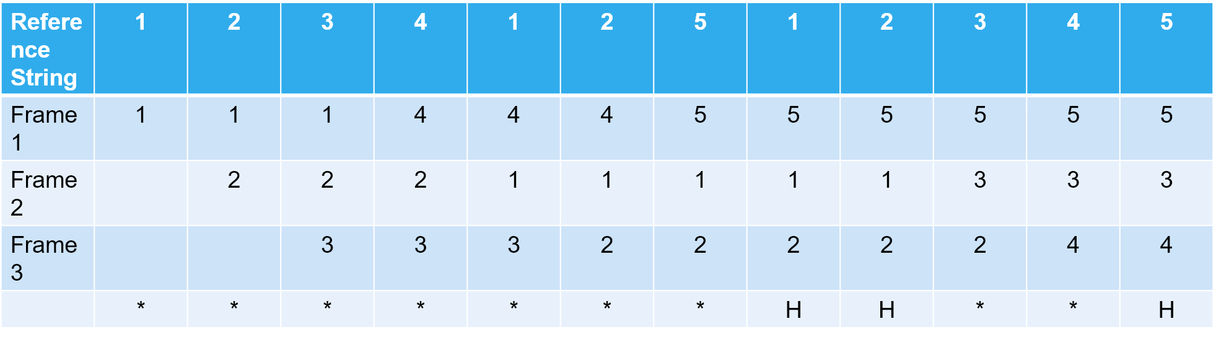
Example
Number of pages:12
Reference String: 1,2,3,4,1,2,5,1,2,3,4,5
Number of frames:3
Number of pages:12
Reference String: 1,2,3,4,1,2,5,1,2,3,4,5
Number of frames:3

Slide 20
FIFO program [c++]
#include<bits/stdc++.h>
using namespace std;
int main()
{
int i,j,k,n,no,avail;
float fcount=0;
printf("\n ENTER THE NUMBER OF PAGES [reference string length]:\n");
scanf("%d",&n);
int ref_str[n+1];
printf("\n ENTER THE REFERENCE STRING :\n");
for(i=1;i<=n;i++) // accept entire reference string
scanf("%d",&ref_str[i]);
printf("\n ENTER THE NUMBER OF FRAMES :");
scanf("%d",&no);
int frame[no];
for(i=0;i<no;i++)
frame[i]= -1;
j=0;

Slide 21
printf("\n page \t page frames \tHit/Fault\n");
for(i=1;i<=n;i++)
{
printf("%d\t\t",ref_str[i]);
avail=0; // Default value of available flag is 0
for(k=0;k<no;k++)
{
if(frame[k]==ref_str[i]) //input of page request is compared with existing FRAME content
{
avail=1; // as page found available is turned 1
for(k=0;k<no;k++)
printf("%d\t",frame[k]); // Print Current state of FRAME
printf("H"); // Indication of Page Hit
}
}

Slide 22
if (avail==0) // input page requested NOT existing in FRAME
{
frame[j]=ref_str[i]; // place page requested at j th location in FRAME
j=(j+1)%no; // Update J for next Cycle
fcount++; // Increment Counter for Page Fault
for(k=0;k<no;k++)
printf("%d\t",frame[k]); // Print Current state of FRAME
printf("F"); // Indication of Page Fault
}
printf("\n");
}
printf("Page Fault Is %.1f\n",fcount);
cout<<"Hit ratio: "<<((n-fcount)/n)<<"\n";
cout<<"Miss ratio: "<<(fcount/n);
return 0;
}

Slide 23
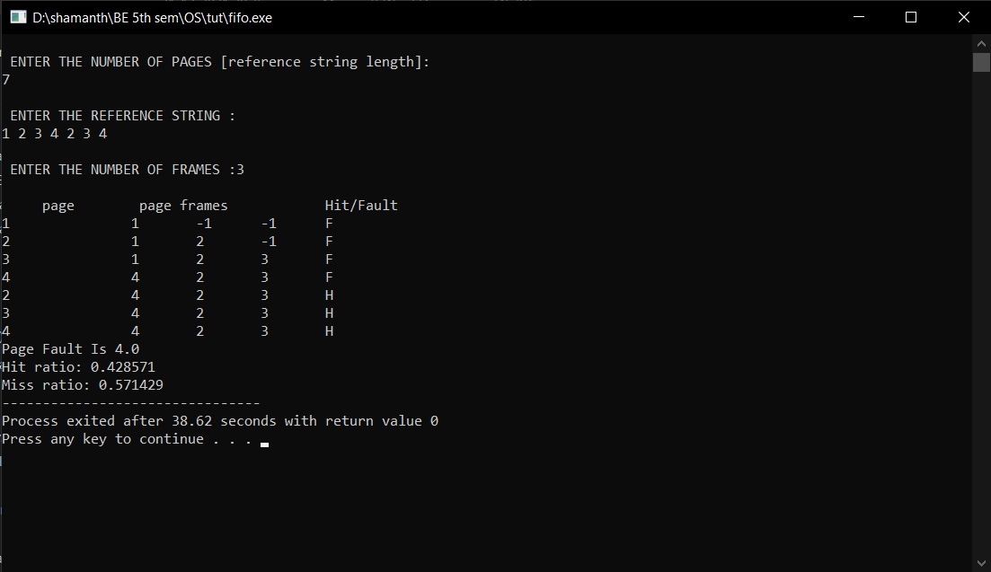
output

